Slide 1

Memory Technologies Spring 2024
Hamed Farbeh
farbeh@aut.ac.ir
Department of Computer Engineering
Amirkabir University of Technology

Slide 2
Reference (for this lecture)
Design Exploration of Emerging Nano-scale Non-volatile Memory, Hao Yu and Yuhao Wang, Springer, 2014
Memory Technologies, Spring 2024, AUT, Tehran, Iran

Slide 3
Nanoscale Limitations
Functional failure due to PVs
Mismatch among transistors
Positive feedback: leakage power and heat
Thermal runaway failure
Memory Technologies, Spring 2024, AUT, Tehran, Iran

Slide 4
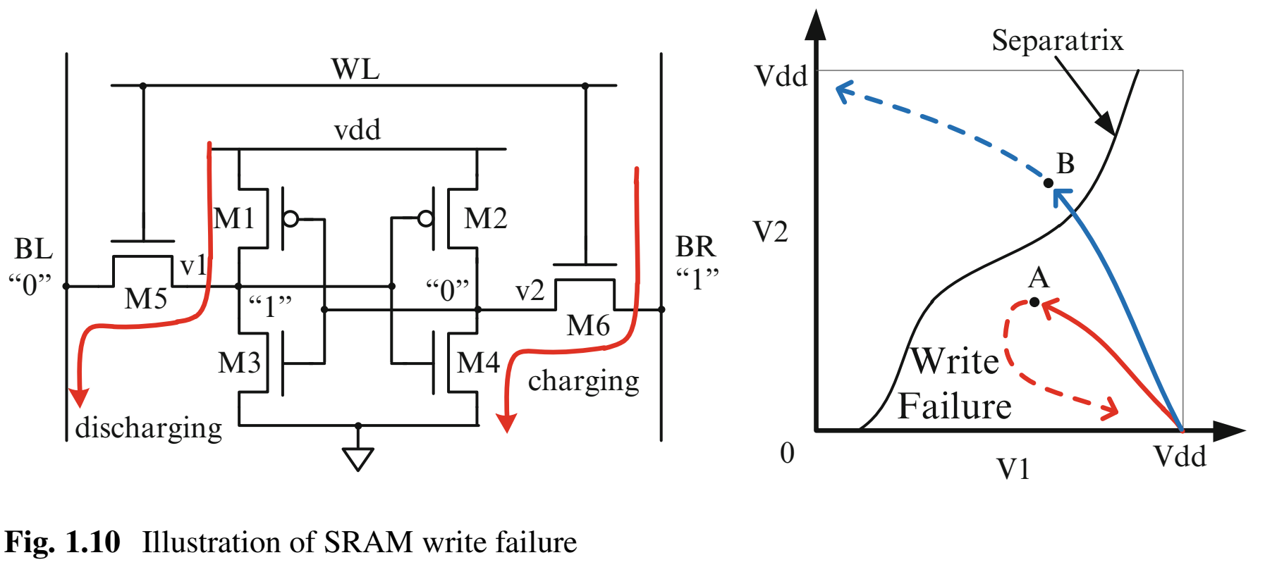
Nanoscale Limitations
Write Failure
Memory Technologies, Spring 2024, AUT, Tehran, Iran

Slide 5
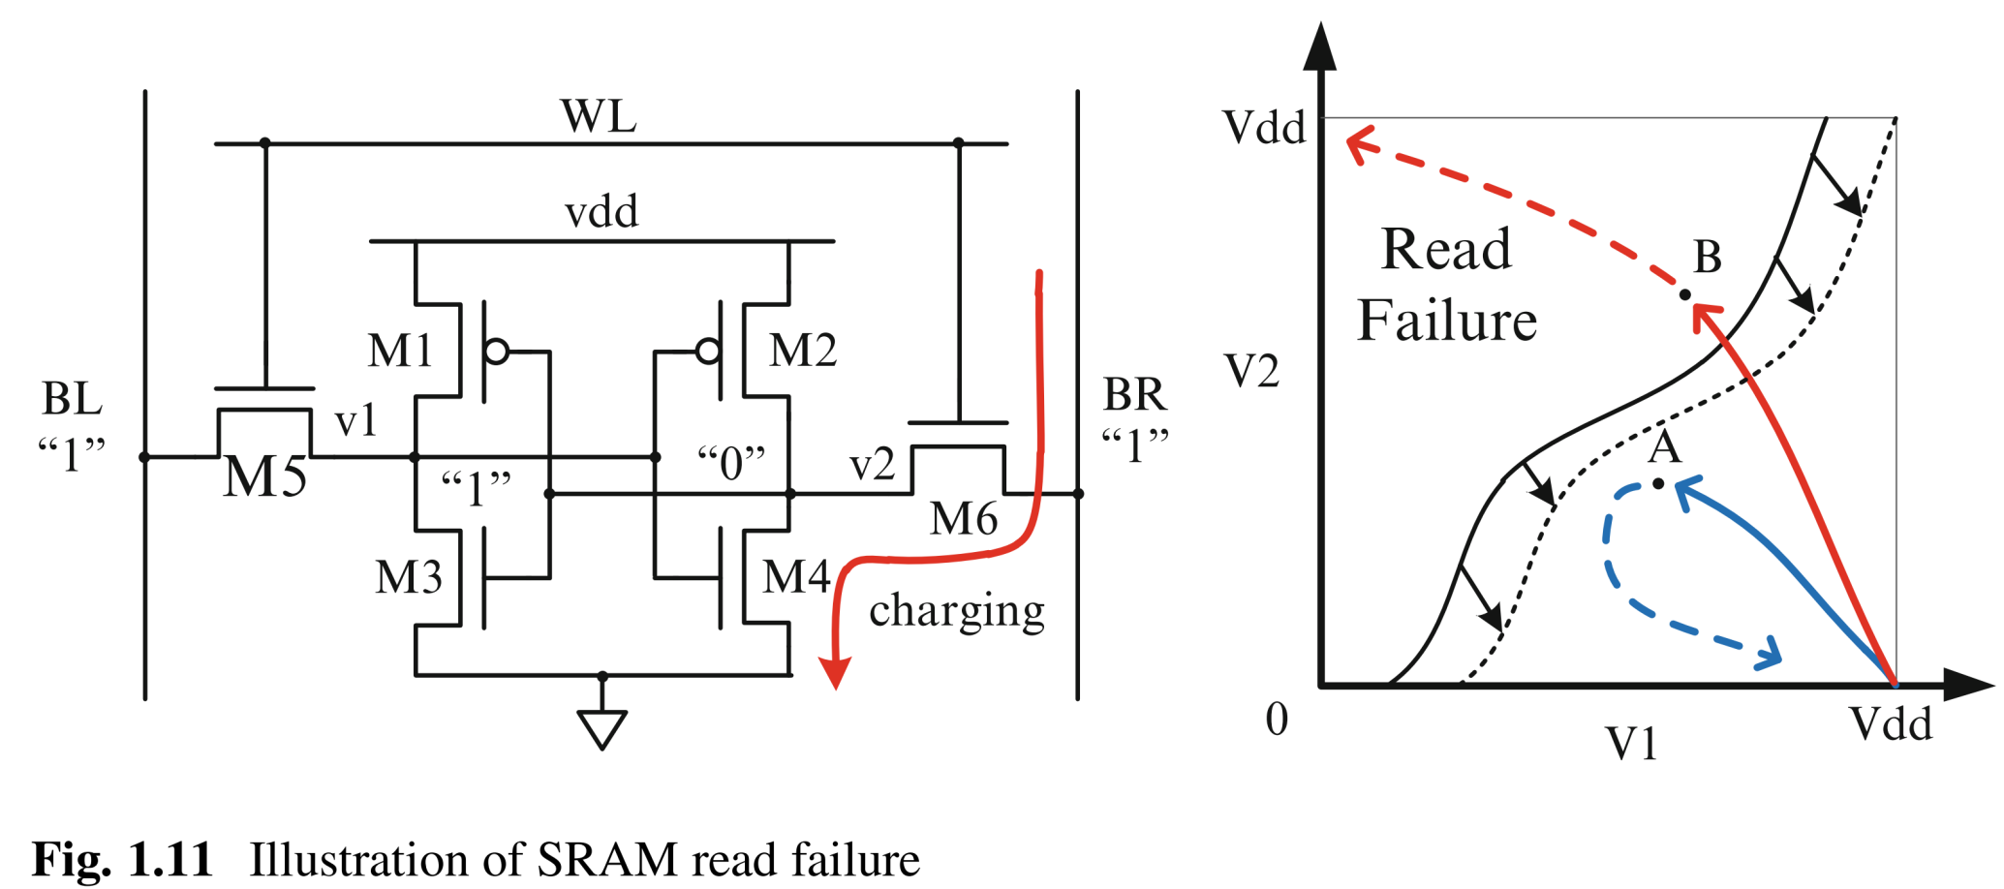
Nanoscale Limitations
Read Failure
Memory Technologies, Spring 2024, AUT, Tehran, Iran

Slide 6
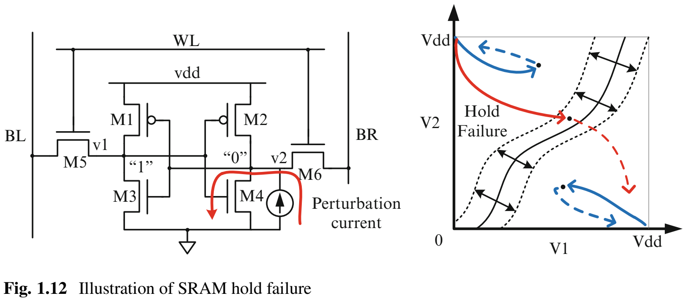
Nanoscale Limitations
Hold Failure: external noise or SEU
Memory Technologies, Spring 2024, AUT, Tehran, Iran

Slide 7
Nanoscale Limitations
Thermal runaway
A situation where an increase in temperature changes the conditions in a way that causes a further increase in temperature in positive feedback.
In memory
Electrical–thermal coupling between leakage power and temperature
Memory Technologies, Spring 2024, AUT, Tehran, Iran

Slide 8
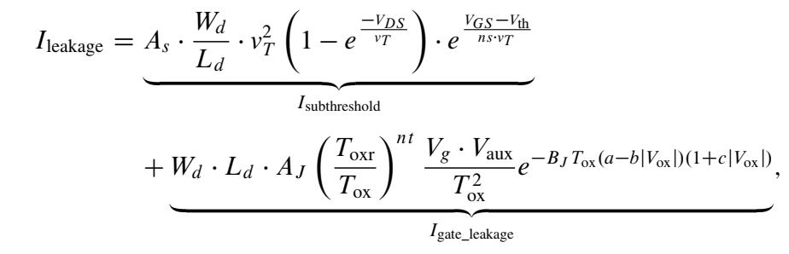
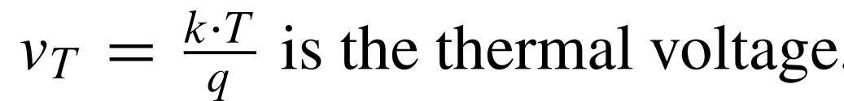
Nanoscale Limitations
Memory leakage current
Memory Technologies, Spring 2024, AUT, Tehran, Iran

Slide 9
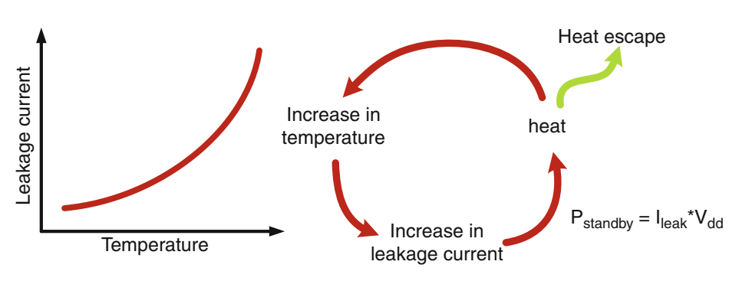
Nanoscale Limitations
Thermal accumulation
If the thermal source grows much faster than the heat removal ability of heat sink
Memory Technologies, Spring 2024, AUT, Tehran, Iran

Slide 10
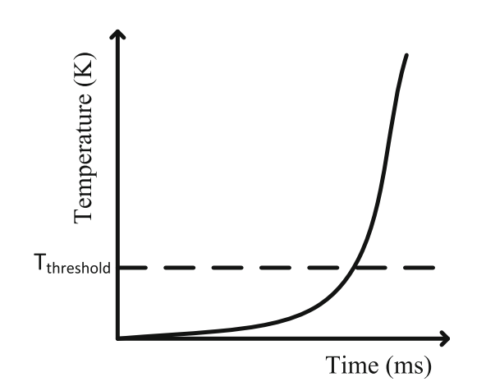
Nanoscale Limitations
Thermal runaway temperature
T_{threshold}: Temperature at which thermal runaway failure happens
Memory Technologies, Spring 2024, AUT, Tehran, Iran

